Slide 1
CSS Properties contd..

Slide 2
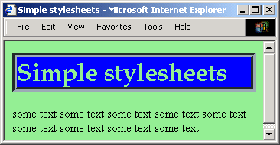
Style rules
Some properties can be given multiple values
The browser first looks for the "Book Antiqua" font
If this is not on the system, it looks for the Times font
Last resort: the browser uses the generic serif font
body {
background-color: lightgreen;
}
h1 {
color: lightgreen;
background-color: blue;
font-family: "Book Antiqua", Times, serif;
border: thick groove #9baab2;
}

Slide 3
Properties and values
Fonts
font-family: <family name> [<generic family>]
font-style: normal | italic | oblique
font-weight: normal |bold |bolder |lighter
font-size: small| medium| large| smaller| larger
Backgrounds and colours
color: <value>
background-color: <value>|transparent
background-image: URL|none

Slide 4
Properties and values
Text
text-decoration: none|underline|overline|line-through
text-transformation: none|capitalize|uppercase|lowercase
text-align: left|right|center|justify
text-indentation: length|percentage
Example: To remove underlining on links:
a:link, a:visited, a:active{text-decoration: none}

Slide 5
Properties and values
Boxes
margin: length|percentage|auto {1,4}
border-width: thin|thick|medium|length {1,4}
padding: length|percentage {1,4}
border-color: value {1,4}
border-style: none|dotted|dashed|solid|double|groove {1,4}
ridge: value {1,4}
width: length|percentage|auto
height: length|auto

Slide 6
Properties and values
Position
location: absolute|relative|fixed
absolute: relative to upper left corner of window
relative: relative to the last item
fixed: does not move when the page is scrolled
left: distance from left border of window (pixels, %)‏
top: distance from top border of window (pixels, %)‏

Slide 7
<DIV> & <SPAN> are your friends
<div> and <span> tags allow you define exceptions to the general rules of your body text…and they are helpful tools for document designers and web developers
<div> is usually used to designate styles for block elements that should stand apart from the body text…like callout quotes. Everything inside a <div> tag takes on the <div> attributes…and you can specify classes and ids for <div> too!

Slide 8
Divisions and spans
Rather than applying styles to an element itself, we wrap the element in
a div element (usually for block elements), or
a span element (usually for inline elements)‏
Any required formatting can then be applied to the <div> or <span> element.
Div and span elements become part of the document
In particular, each can have class and id attributes

Slide 9
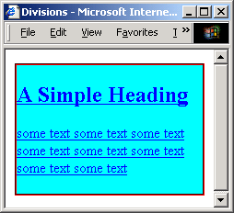
Divisions
<head>
<style>
<!--
.myclass {
color: blue;
background: cyan;
text-decoration: underline;
border: thin groove red;
}
-->
</style>
</head>
<body>
<div class="myclass">
<h2>A Simple Heading</h2>
<p>some text . . . </p>
</div>
</body>
Styles can be applied to blocks of HTML code using div

Slide 10
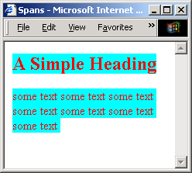
Spans
spans are similar to divisions
<head>
<style>
<!--
.myclass {
color: red;
background: cyan;
text-decoration: none;
}
-->
</style>
</head>
<body>
<span class="myclass">
<h2>A Simple Heading</h2>
<p>some text . . . </p>
</span>
</body>

Slide 11
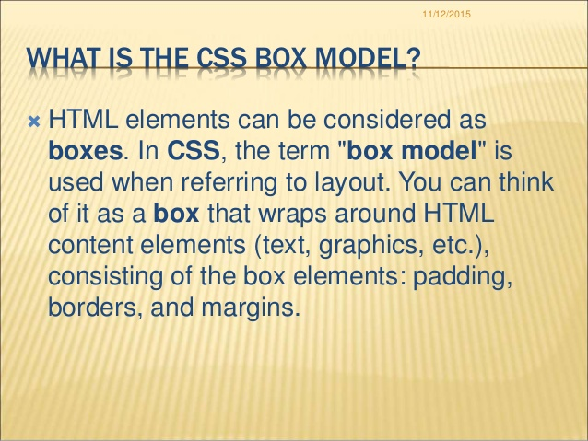

Slide 12
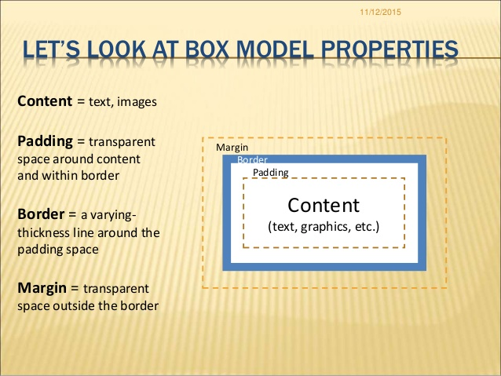

Slide 13
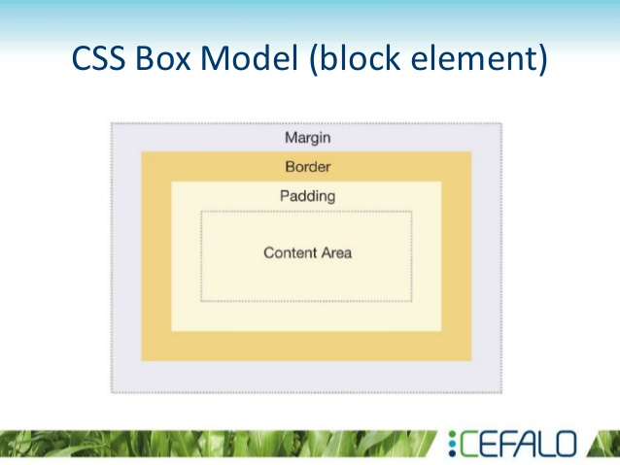

Slide 14
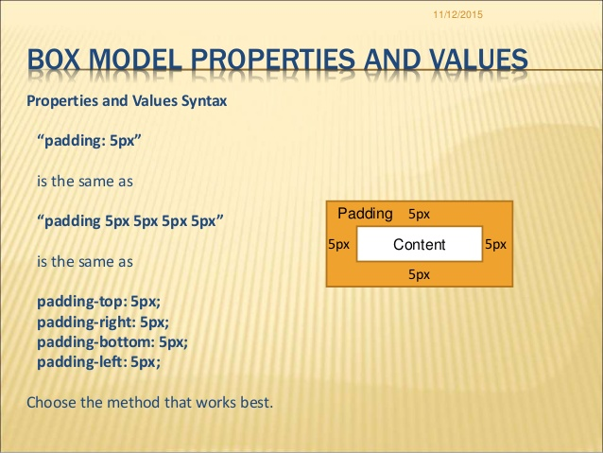

Slide 15
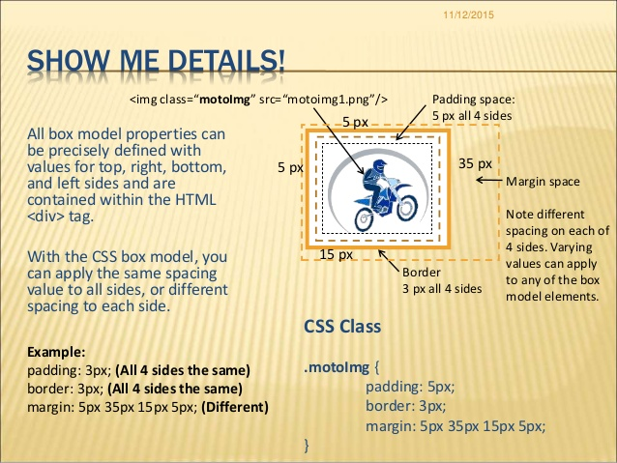

Slide 16
